Slide 1

MES 503 Lab 7
Kayla Blincow, PhD

Slide 2

Announcements
Working on grading latest lab assignments

Slide 3
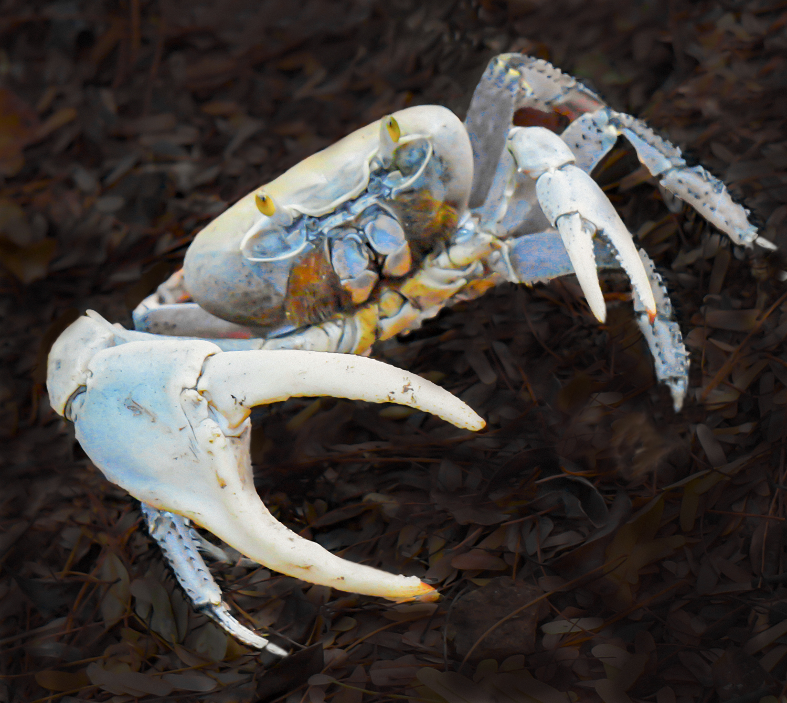
ANOVA Theory: Land Crabs
We have been told by local harvesters that land crabs grow bigger depending on where they are found on the island. We want to see if this is true.
We go out to three of the most used areas for capturing land crabs (West End, Magens Bay, Compass Point), capture 10 crabs each, and measure them.

Slide 4

ANOVA Theory: Land Crabs
Null Hypothesis:
Alternative Hypothesis:
There is no difference in mean size of crabs from the different capture locations.
There is a difference in mean size of crabs from the different capture locations.

Slide 5
ANOVA Theory: Land Crabs
Assumptions
Independent samples
Homoscedasticity (aka equal variance) among groups
Normally distributed residuals
*Note that ANOVAs are generally robust to violations of assumptions

Slide 6
Tukey’s HSD
REMINDER: we cannot run multiple t-tests because it will inflate our Type I error rates
Compares all groups against each other
  Similar to what multiple t-tests would do
Controls for fact that we are doing multiple comparisons by adjusting p value to maintain experiment-wise error rate (alpha; usually 0.05)

Slide 7
Switch to ze code!

Slide 8
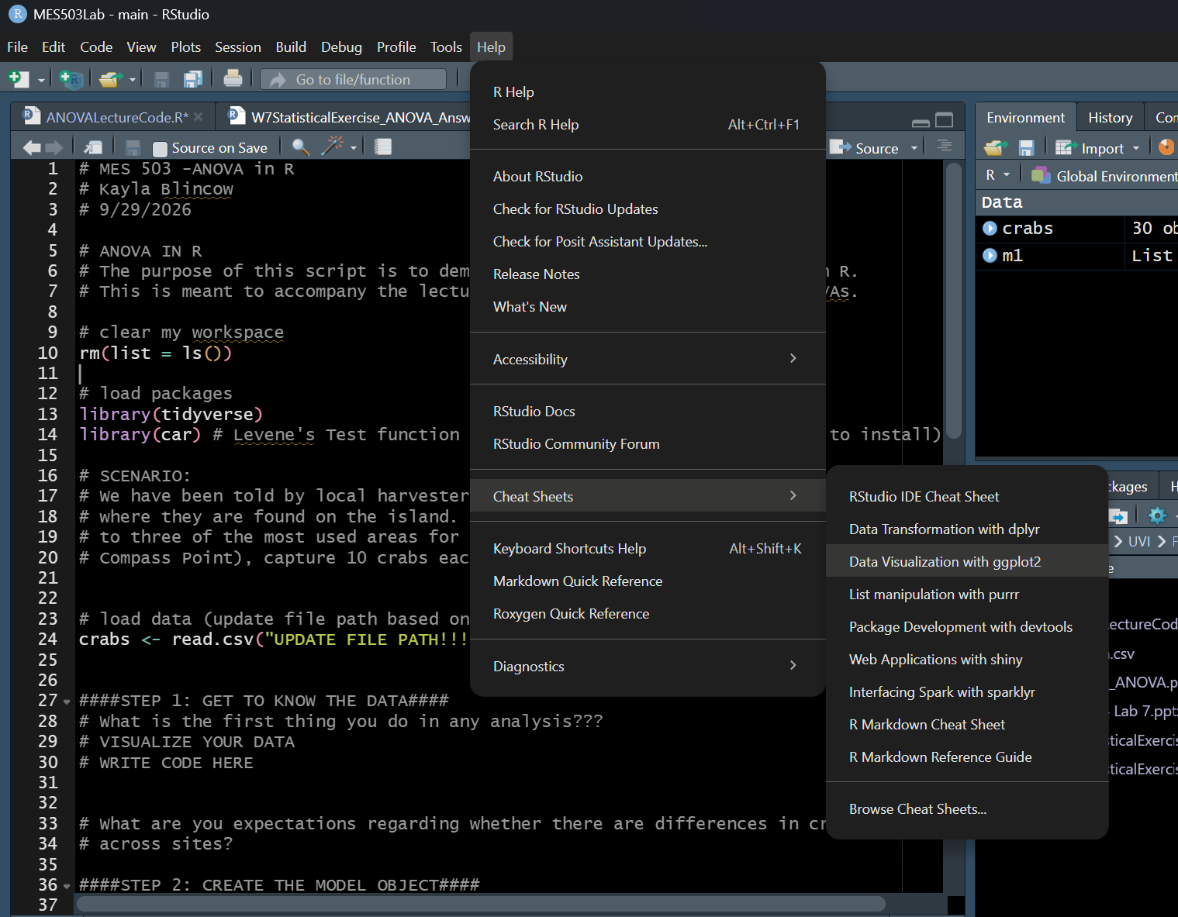
R Cheatsheets

Slide 9
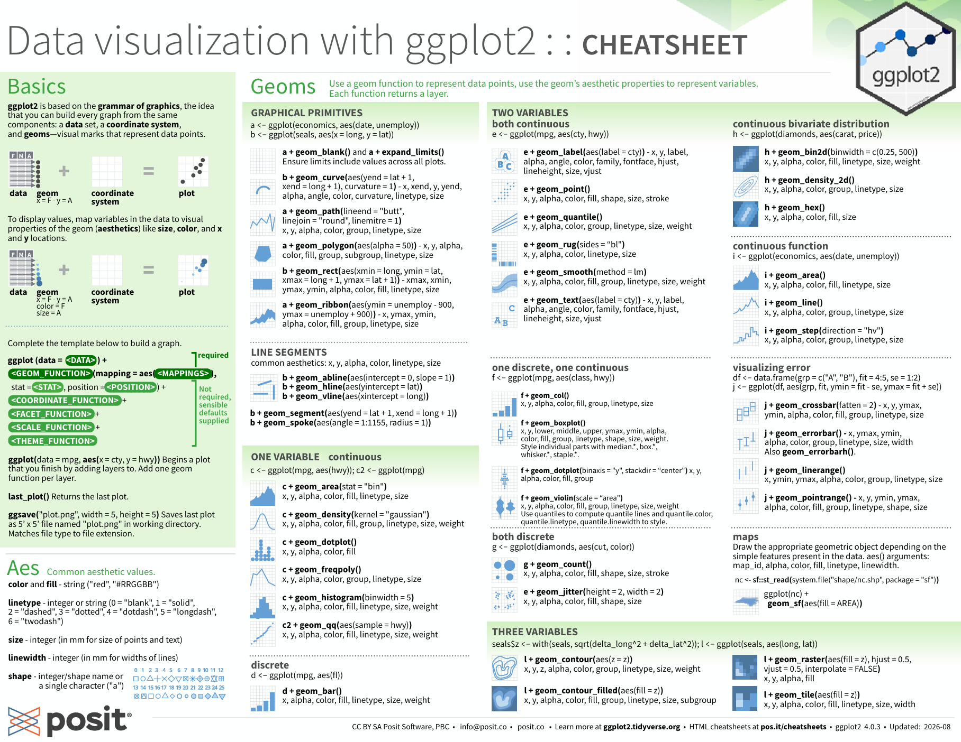

Slide 10
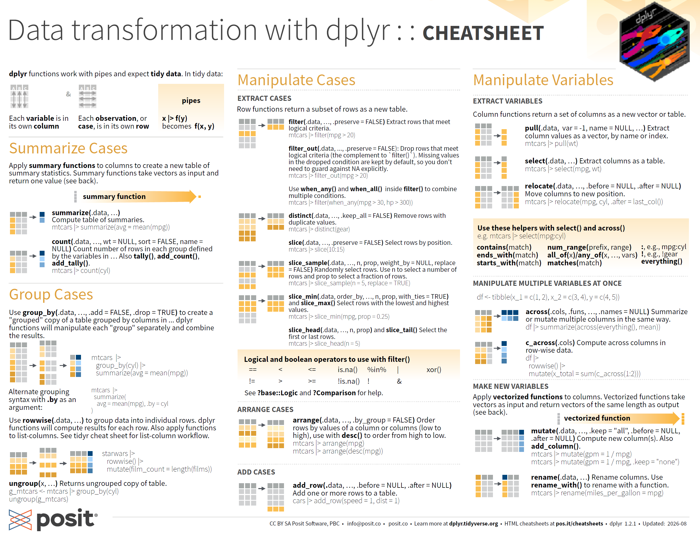

Slide 11
And more!
Posit Cheatsheets
Notes:
Specifically look at dplyr and joins

